Slide 1

IoT Air Quality Monitoring System
An end-to-end solution for real-time environmental monitoring.

Slide 2


System Overview
This project uses an ESP32 to monitor air quality, store data, visualize trends, and
enable remote control.
ESP32 Microcontroller
Core data collection and control.
InfluxDB
Time-series data storage.
Grafana
Data visualization dashboards.
Android App
Remote control and data access.

Slide 3





System Architecture: Data Flow
Sensors collect data, ESP32 publishes via MQTT, Node-RED processes, InfluxDB stores, and Grafana visualizes.
Sensors
Collect environmental data.
ESP32
Publishes data via MQTT.
Node-RED
Aggregates and processes data.
InfluxDB
Stores time-series data.
Grafana
Visualizes trends.

Slide 4
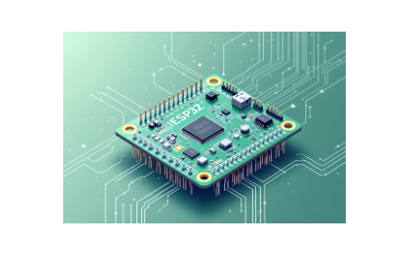
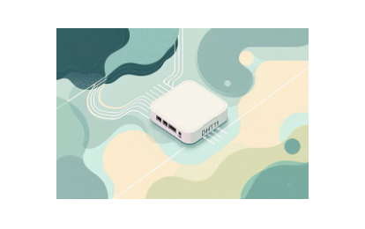
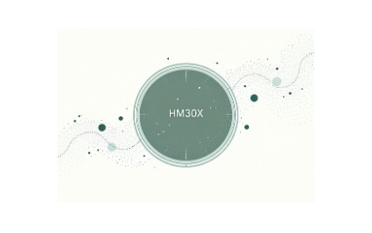






Key Technologies
A robust stack ensures real-time monitoring and control.
From microcontrollers to containerization, each component plays a vital role.

Slide 5
Hardware Components
ESP32 Microcontroller
Reads sensor data
Connects to Wi-Fi
Publishes via MQTT
Listens for LED commands.
Sensors & Actuator
DHT11: Temperature & Humidity
HM330X: Particulate Matter (PM1.0, PM2.5, PM10)
LED at Pin 21: Controlled via MQTT (ON/OFF)

Slide 6
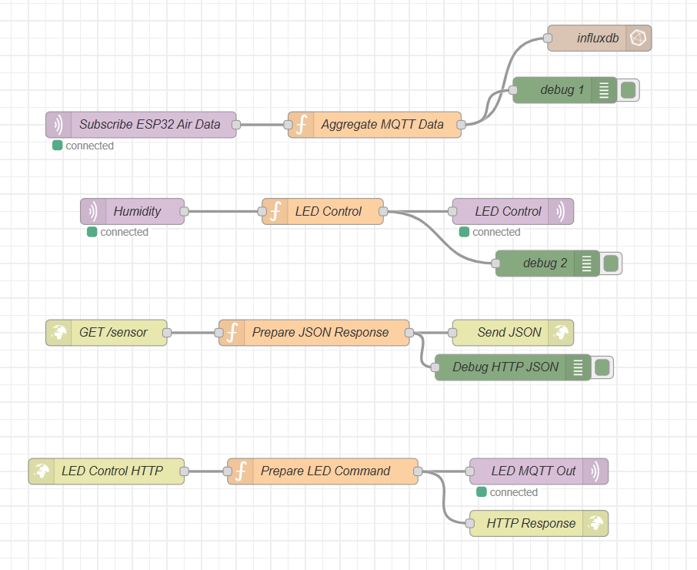
Node-Red Flow

Slide 7
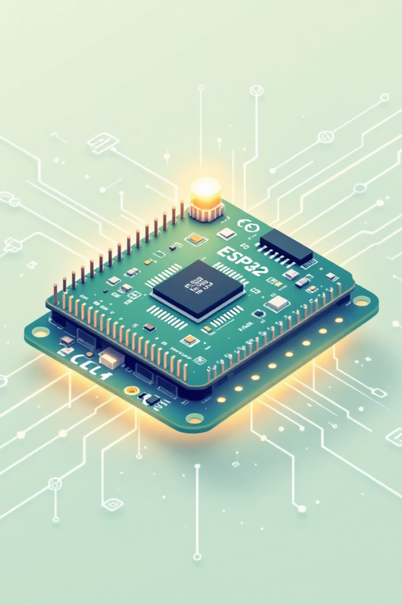
ESP32 Firmware Design
The ESP32 handles Wi-Fi, MQTT communication, sensor data processing, and LED control.
1
Wi-Fi & MQTT
Connects to network, publishes sensor data, subscribes to LED commands.
2
Sensor Data Processing
Reads PM and DHT11 data, publishes every 5 seconds.
3
Air Quality Classification
Categorizes PM2.5 levels: GOOD, MODERATE, UNHEALTHY, DANGEROUS.
4
LED Control Logic
Switches LED ON/OFF based on MQTT messages from Node-RED.

Slide 8

Node-RED: Data Processing & Automation
Node-RED orchestrates data flow, calculates air quality, and manages LED control.
01
02
Sensor Data Flow
LED Control Flow
Subscribes to MQTT, aggregates data, calculates air quality, stores in InfluxDB.
Mobile app sends HTTP POST, Node-RED publishes to MQTT, ESP32 controls LED.
03
Dashboard Buttons
Node-RED dashboard allows direct LED ON/OFF control via MQTT.

Slide 9
Data Storage & Visualization
InfluxDB:
Time-Series Database
Grafana:
Real-time Dashboards
Stores air quality measurements including PM1.0, PM2.5, PM10, Temperature, Humidity, and Air Quality Level.
Visualizes historical and live trends for PM, temperature, humidity, and air quality, aiding environmental analysis.

Slide 10
Android Mobile Application
The mobile app provides a user-friendly interface for monitoring and control.
Live Sensor Data
Fetches and displays PM, temperature, humidity, and air quality text via REST API.
LED Control
Sends ON/OFF commands to Node-RED, which then publishes to the ESP32 via MQTT.

Slide 11
Conclusion & Future Enhancements
A scalable, modular, real-time IoT system for smart cities and indoor monitoring.
System Advantages
Scalable & Modular
Real-time Monitoring
Smart City & Indoor Applications
Future Enhancements
Cloud Hosting (AWS/Azure)
User Authentication
Push Notifications
Additional Sensors (CO2, VOC)

